Slide 1
Introduction to Functions
(Topic V From DS 240 In The Catalog)

Slide 2
Lesson Setup

Slide 3
Materials Used in this Lesson
Lesson materials are contained in the lesson git repo.
Create a new folder for the lesson materials.
Open command line and cd into the lesson directory.
Run command git clone https://github.com/skylarcalvin/SkylarCalvin_DS240_Sample_Lecture.git
This will pull down the Lesson notebook, slide presentation, and dataset.
Lecture notes are contained in the Introduction_to_Functions.ipynb notebook.
A Jupyter Notebooks environment with the Pandas package installed required to run the lesson from.
Sample dataset.
titanic.csv.
Contains basic information on the passenger manifest from the RMS titanic.
Notes:
If you wish download the git repo and open the notebook to follow along with.

Slide 4
Lesson Objectives
Define what a Python function is in a concise way to aid in student understanding.
Discuss when a function might be used and in what context.
Develop a solid understanding of function syntax.
Demonstrate how to use arguments in functions, and how to return values.
Define scope in relation to function variables.
Gain an understanding of how useful reusable functions are through demonstration.

Slide 5
Function Fundamentals

Slide 6
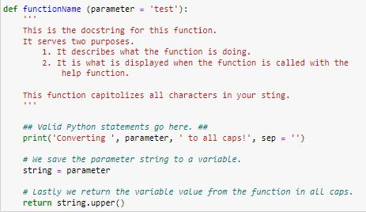
What is a Function?
Defined as a collection of related Python statements that perform a specific task.
Primary building block of code organization in Python.
Make code more readable by giving code a name.
Reusable code that is easy to call.
Notes:
So this is what a function looks like in Python.
A function is defined as a collection of related statements that perform a specific task.
In the scope of object oriented programming, functions are the primary building block for code organization in Python.
In practicality they serve two purposes.
They make your code more readable by giving it a name.
And they make your code reusable.

Slide 7
Basic Function Syntax
A function has seven parts:
Notes:
There are seven parts to a function’s syntax.
I will briefly run through these for you.
Note that the first four of these are part of what’s called the function header.

Slide 8
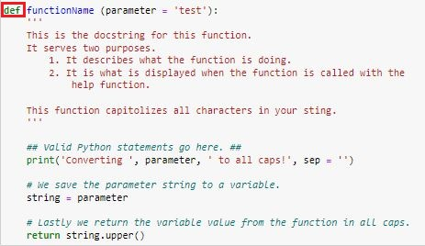
Basic Function Syntax
A function has seven parts:
The def keyword which marks the start of the function head.
Notes:
The function header starts off with the def keyword.
This tells the Python interpreter that a function is being started.

Slide 9
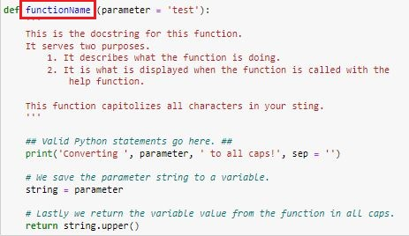
Basic Function Syntax
A function has seven parts:
The def keyword which marks the start of the function head.
A function name to identify the function.
Notes:
Next there’s the function name.

Slide 10
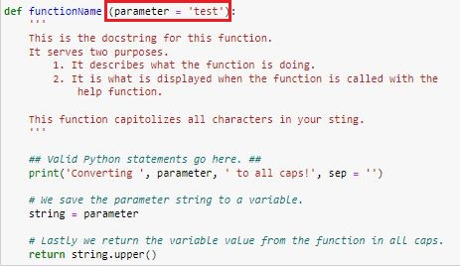
Basic Function Syntax
A function has seven parts:
The def keyword which marks the start of the function head.
A function name to identify the function.
Optional parameters or arguments through which we pass values to a function.
Notes:
The function argument.
Note how in the case of this function, the argument is assigned an argument.
This is called the default value of the argument.
If no arguments are passed to the function when it’s called, Python will pass in the default value for the argument.

Slide 11
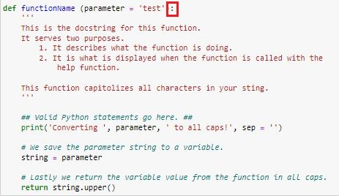
Basic Function Syntax
A function has seven parts:
The def keyword which marks the start of the function head.
A function name to identify the function.
Optional parameters or arguments through which we pass values to a function.
A colon (:) to mark the end of the function header.
Notes:
Lastly the function header is closed by a colon.
The colon indicates to the interpreter that an object is being created.
It sets the syntax for the rest of the function.
Notice how every thing below the header is neatly indented.
Indention is very important in Python.
Wherever there’s a colon, no matter what the object (class, function, if else statement, etc) all subsequent lines in that code must be indented or an error will result.

Slide 12
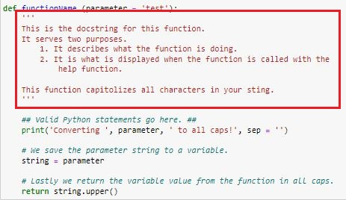
Basic Function Syntax
A function has seven parts:
The def keyword which marks the start of the function head.
A function name to identify the function.
Optional parameters or arguments through which we pass values to a function.
A colon (:) to mark the end of the function header.
An optional documentation string (commonly referred to as a docstring).
Notes:
Next, there’s the docstring, otherwise known as the documentation string.
The docstring provides information about the function such as what it does, and what the arguments are.
Occasionally you will see information on the function’s author as well.
While optional, it’s generally good practice to include one.
It helps other developers who view view your code to pick up where you left off.
If the help() function is called on your function, it will display the docstring.

Slide 13
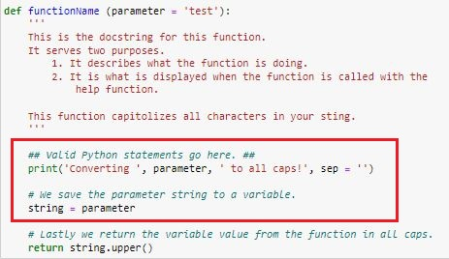
Basic Function Syntax
A function has seven parts:
The def keyword which marks the start of the function head.
A function name to identify the function.
Optional parameters or arguments through which we pass values to a function.
A colon (:) to mark the end of the function header.
An optional documentation string (commonly referred to as a docstring).
One or more valid Python statements that make up the function body.
Notes:
Next is the python statements in the function body.
They perform the tasks that your function is for.

Slide 14
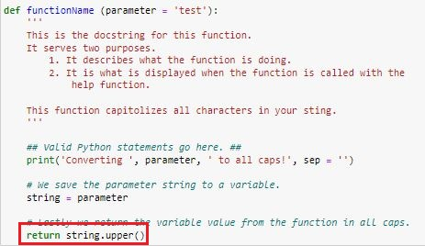
Basic Function Syntax
A function has seven parts:
The def keyword which marks the start of the function head.
A function name to identify the function.
Optional parameters or arguments through which we pass values to a function.
A colon (:) to mark the end of the function header.
An optional documentation string (commonly referred to as a docstring).
One or more valid Python statements that make up the function body.
An optional return statement to return a value from the function.
Notes:
Last is the optional return statement.
This is the output of your function.
Not that functions can have more than one return statement.
To use a function’s returned value, we simply assign the function to a variable.

Slide 15
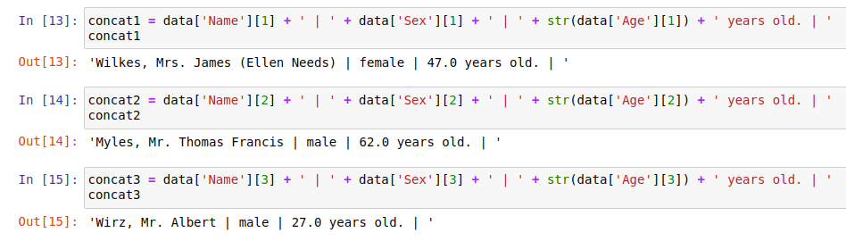
When should a function be used?
As a rule of thumb a function should be used any time a bit of code will be used more than once.
More on this during the demonstration.
Notes:
As a general rule of thumb, any time a code will be used more than once it should be placed in a function.

Slide 16
Function Usage
Notes:
Now lets shift our focus over to how to use a function.

Slide 17
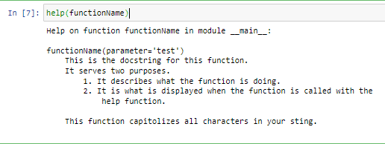
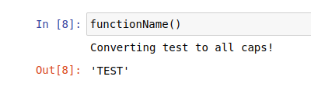
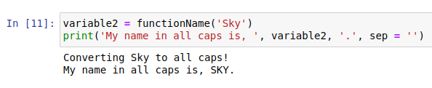
Basic Function Usage
Functions are called by typing the name of the function with parentheses.
function()
A function’s docstring can be read using the help function.
When no arguments are called, the function’s default arguments are used.
When arguments are called, they are passed to the function for use as function variables.
Notice how the return value in the function can be saved to a variable.
Notes:
A function is called by typing its name followed by parentheses.
We may lookup the functions help string using the help() function.
Let’s call the function that we defined earlier with no arguments.
Note how the function used the default argument value defined in the function.
Let’s call the function with an argument.
Note how the default argument was replaced with the value we passed to the function.
Now, to use a returned value, we simply define a variable as the function call.

Slide 18
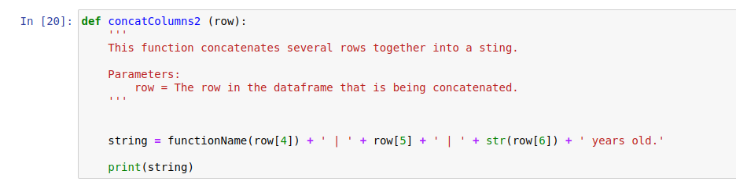
Nested Functions
We can call functions from inside other functions.
functionName is in the global scope.
Notice how I call functionName from inside concatColumns2.
Thus, it’s callable from within concatColumns2, which is also in the global scope

Slide 19
Scope

Slide 20
Global Scope Versus Local Scope
Variables and objects in the global scope are callable from anywhere in the code.
Variables and objects in the local scope are only callable from within the object they are defined in.
A variable defined in one function is not callable from the global environment.
I’ll demonstrate in the Jupyter Notebook.

Slide 21
Practical Function Demonstration in Jupyter

Slide 22
Questions?

